Slide 1
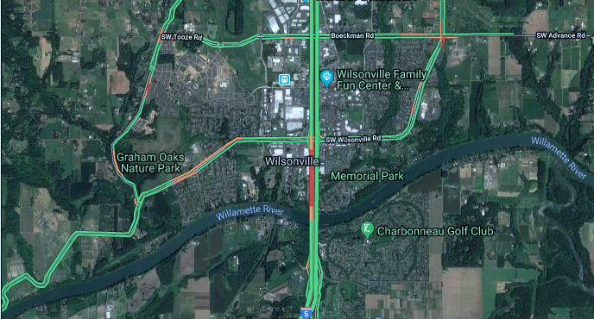
Using Big Data in Freeway Corridor Studies: I-5/Wilsonville Facility Plan
Ray Delahanty, WSP | Maggie Lin, DKS Associates
2019 TRB AppCon
Shaping a smarter transportation experience. ™
Notes:
Change picture

Slide 2
Project Purpose: Regional Context
Notes:
Ray

Slide 3
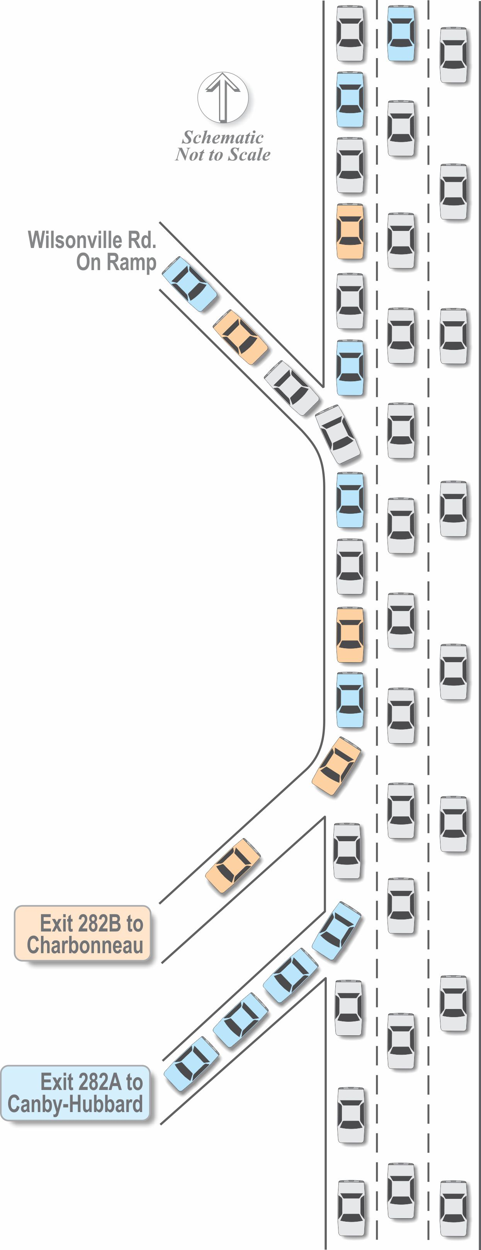
Existing Conditions
Used multiple data sources to understand the corridor performance:
Traditional counts
HERE Data
StreetLight Data
Heavy on-ramp demand
Lane imbalance
Notes:
This slide is a placeholder, in case you want to show this graphic.

Slide 4
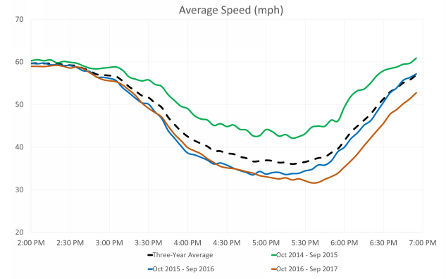
Existing Conditions
Increasing congestion on the freeway
Source: HERE data (ODOT iPeMS)
Three-year trend in travel speed
Worst average speed in 2015: low 40 mph
Worst average speed in 2017: low 30 mph

Slide 5
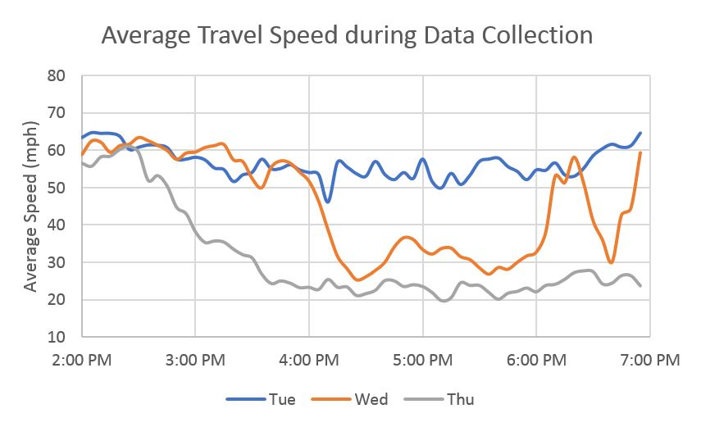
Existing Conditions
Unreliable performance on I-5
What did we find out from 3-day data collection?
Demand: consistent traffic volumes
Operation: significant variation in travel speed on freeway
Source: HERE data (ODOT iPeMS)

Slide 6
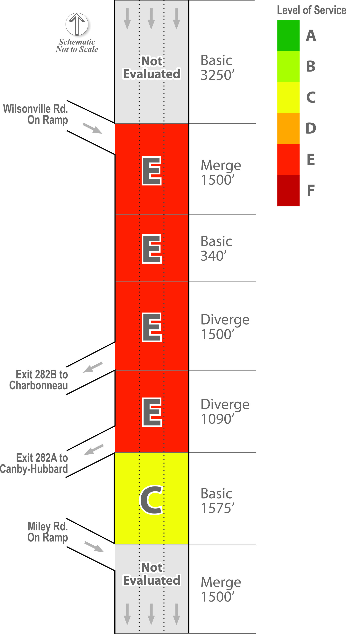
Existing Conditions
HCM Performance Evaluation
High traffic volumes during PM peak hour
Metered on ramp
HCM analysis indicates
Overall congestion in the area
May not reflect observed lane utilization*

Slide 7
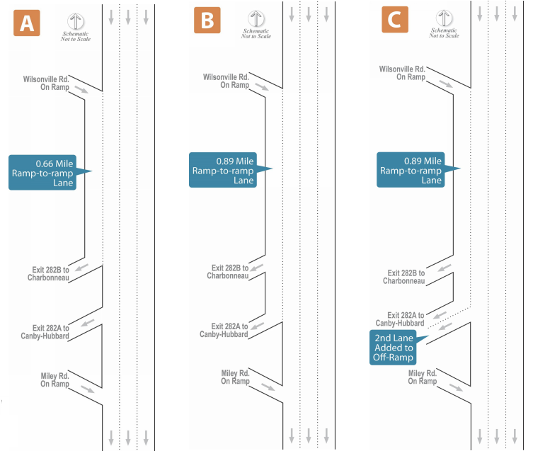
Proposed Alternatives
Southbound auxiliary lane options over the Boone Bridge

Slide 8
Origin-Destination Analysis
StreetLight Data
GPS-based services
Mobile device and GPS data from 23% of US and Canadian adults
12% of commercial truck trips

Slide 9
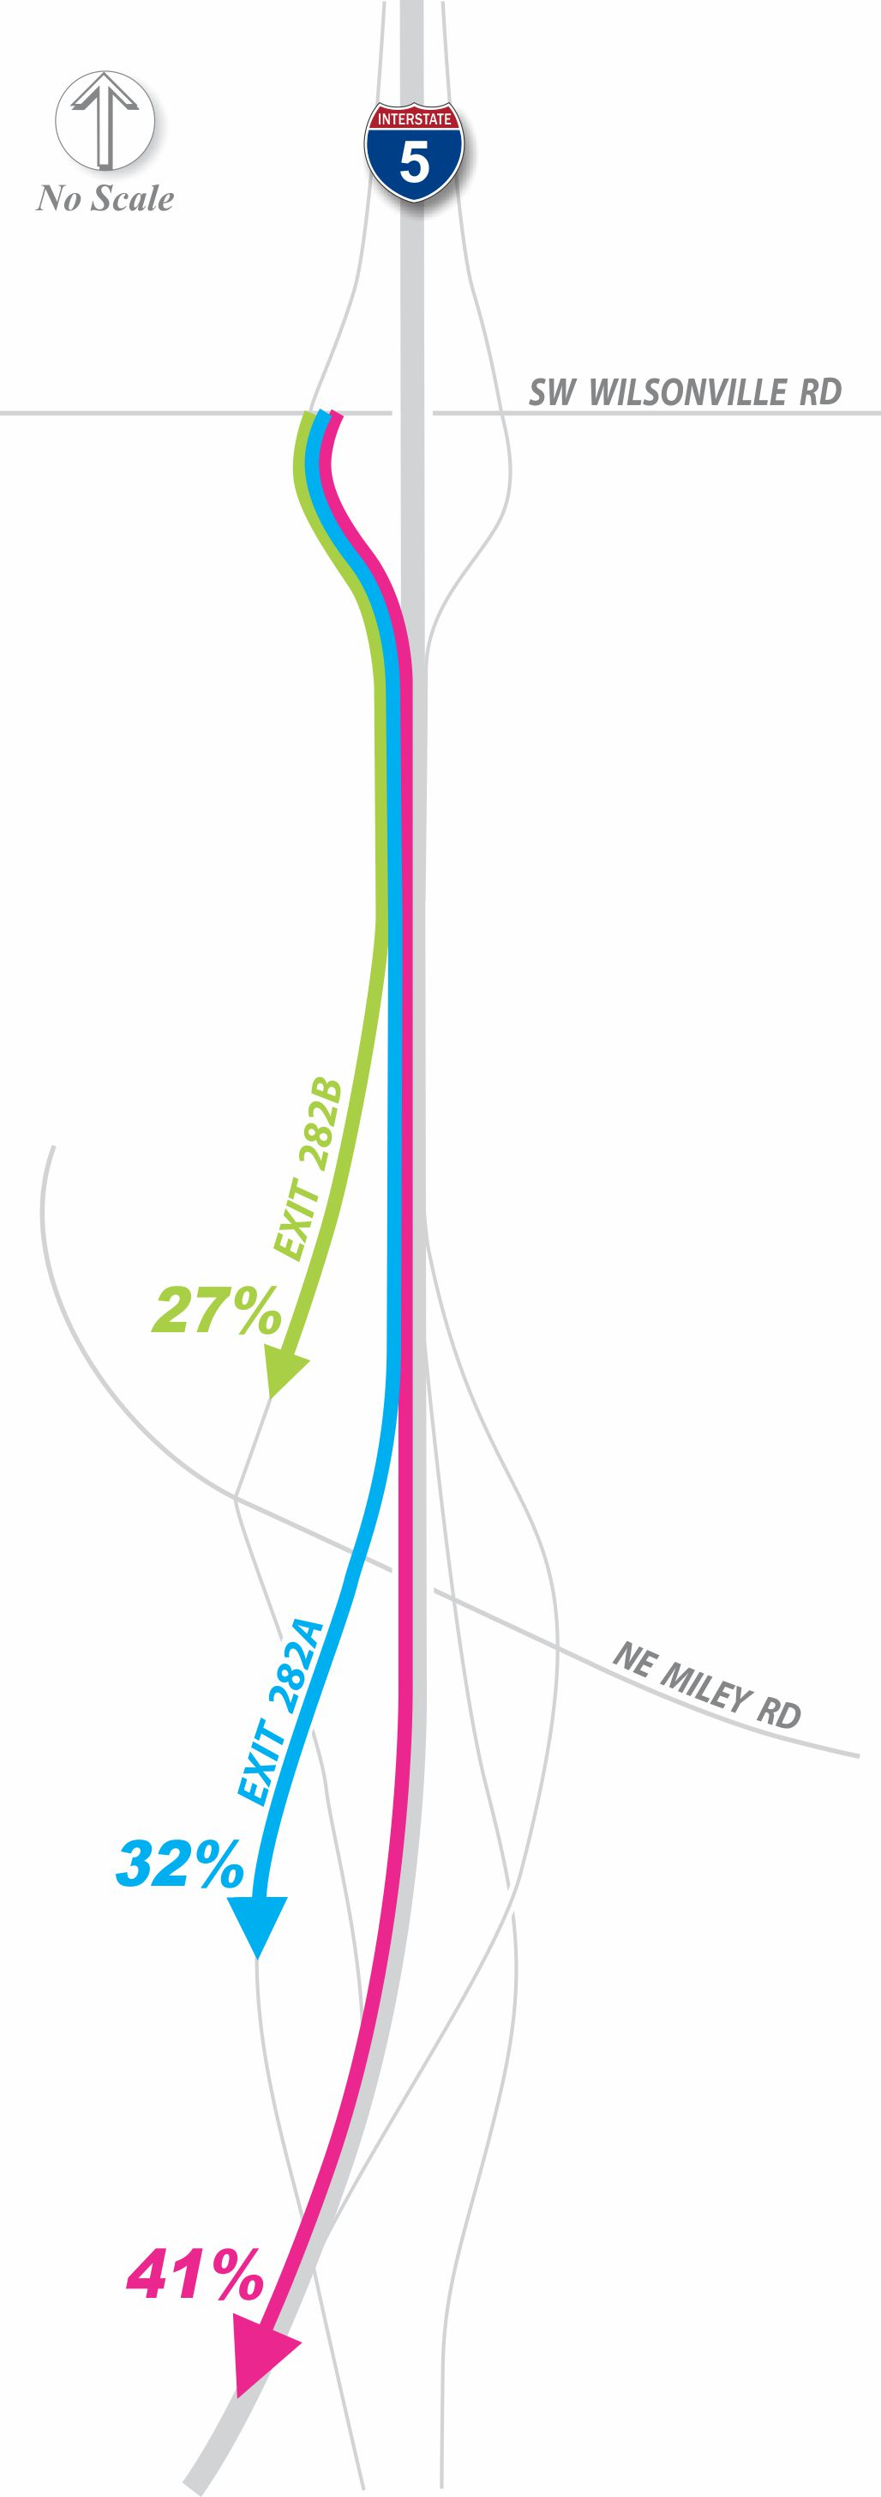
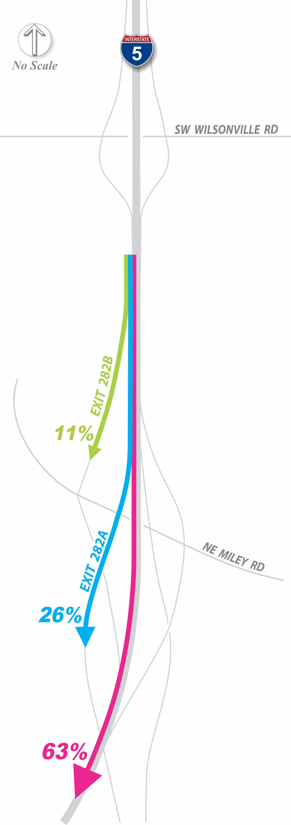
Understanding the Travel Pattern
Using StreetLight Data to Understand OD
+
=
Notes:
Ray – two slides to explain these points

Slide 10
Understanding the Travel Pattern
Data Validation
Does the overall trip distribution match traffic counts?
Analysis Volumes for Alternatives
Post-processed with StreetLight

Slide 11
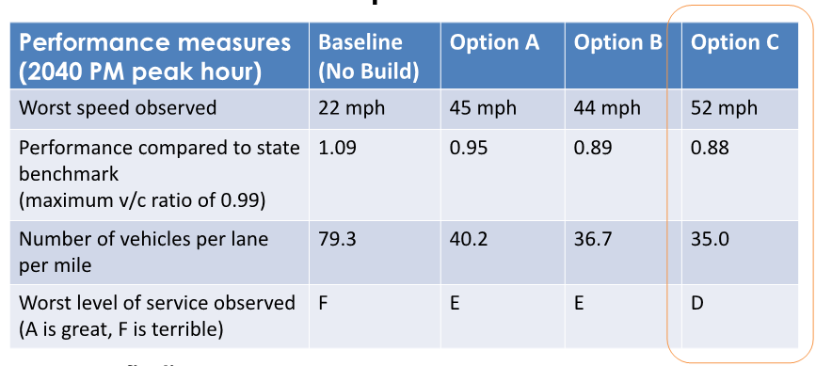
Future Conditions
How do the alternatives perform? HCM Freeway Analysis
Notes:
Key findings:
• All three options improve operations
• The longer the ramp-to-ramp lane, the greater the benefits
• The alternatives with less congestion offer greater reliability
improvements
• Adding a second exit lane in Option C resolves weaving conflicts
• Project costs and potential for environmental impacts mostly come
from making the Boone Bridge wider and more stable (the same in
all options)

Slide 12
Recommended Solution
Recommended Solution

Slide 13
Lessons Learned
Use of Big Data
Can you handle the truth?
Limitations of HCM analysis
Static demand does not reflect variability
Lane imbalance
Questions?
raymond.delahanty@wsp.com
maggie.lin@dksassociates.com
newyorker.com

